Slide 1










Project Overview-What Can I Bake?
Team 1
By: Diego Rivera, Melanie Garcia-Flores, Will Bayer, Yaquelin Chuta, Perla Ortiz

Slide 2
PROJECT GOALS
FIRST GOAL
SECOND GOAL
THIRD GOAL
Save time for beginners and professionals by providing a step-by-step instructions for baking
Our program solves the problem by making it simple to find recipes for different cakes from the list in the program
Help users easily find the recipes without searching online

Slide 3


Description
Suggests recipes based on the users wants and guides them through the recipe
Users can choose a cake or select a random one
The program shows the ingredients and instructions
To get the real recipe data, it links to an API

Slide 4
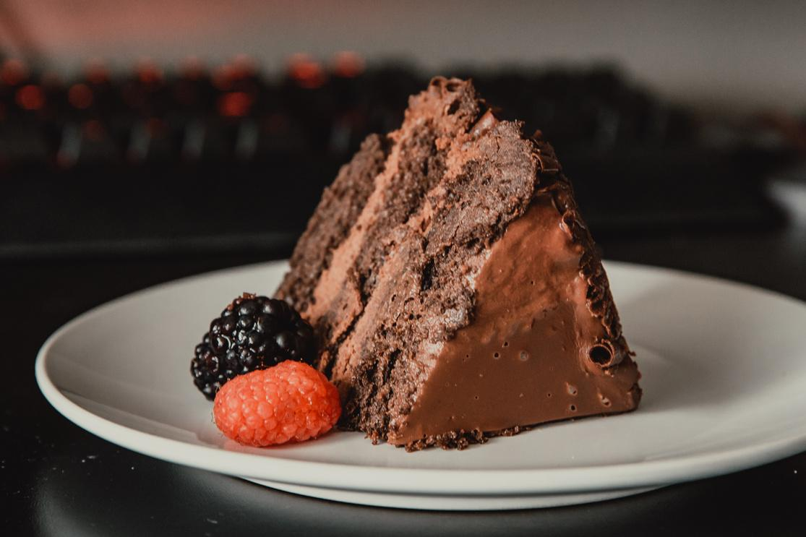
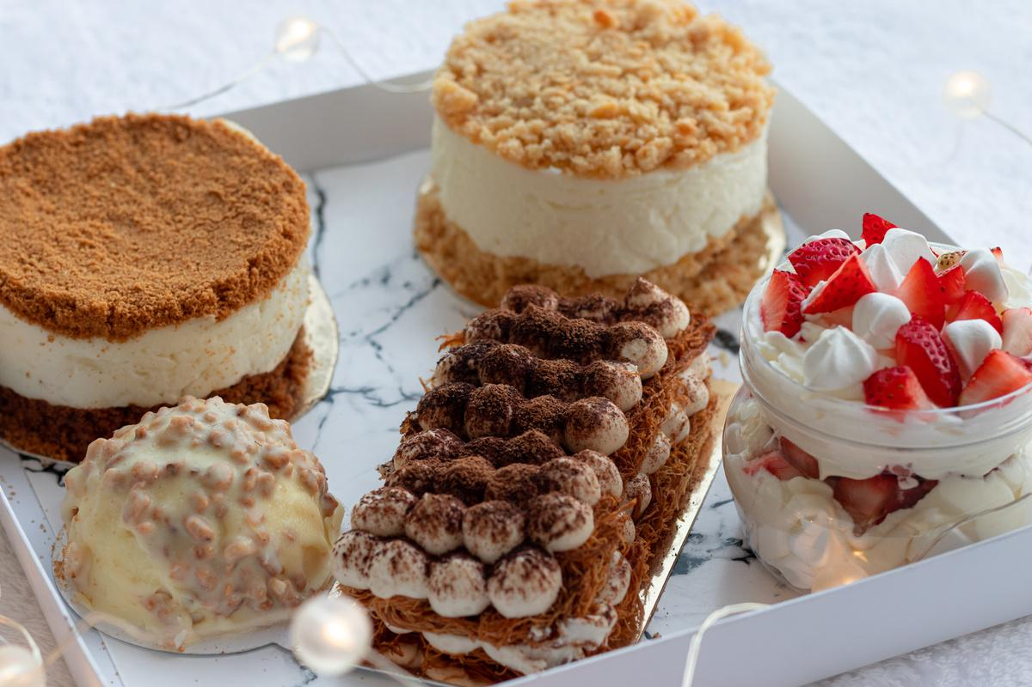
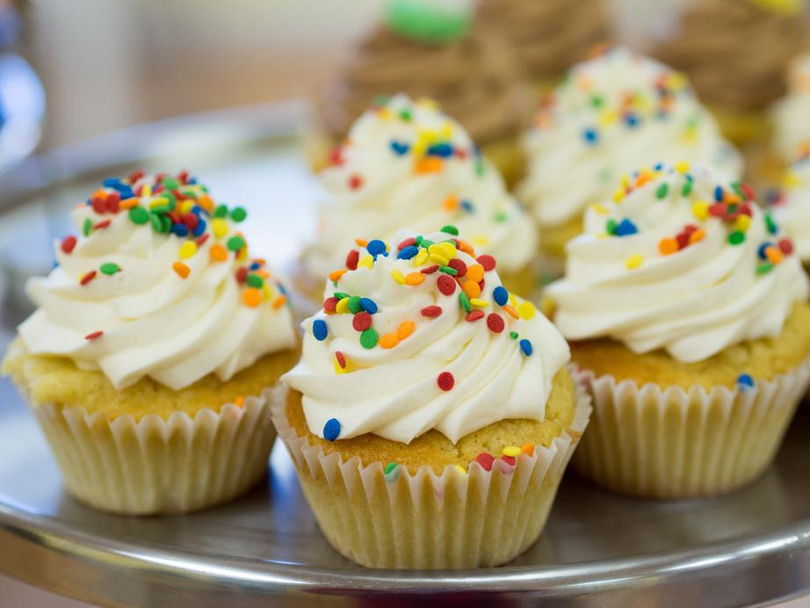
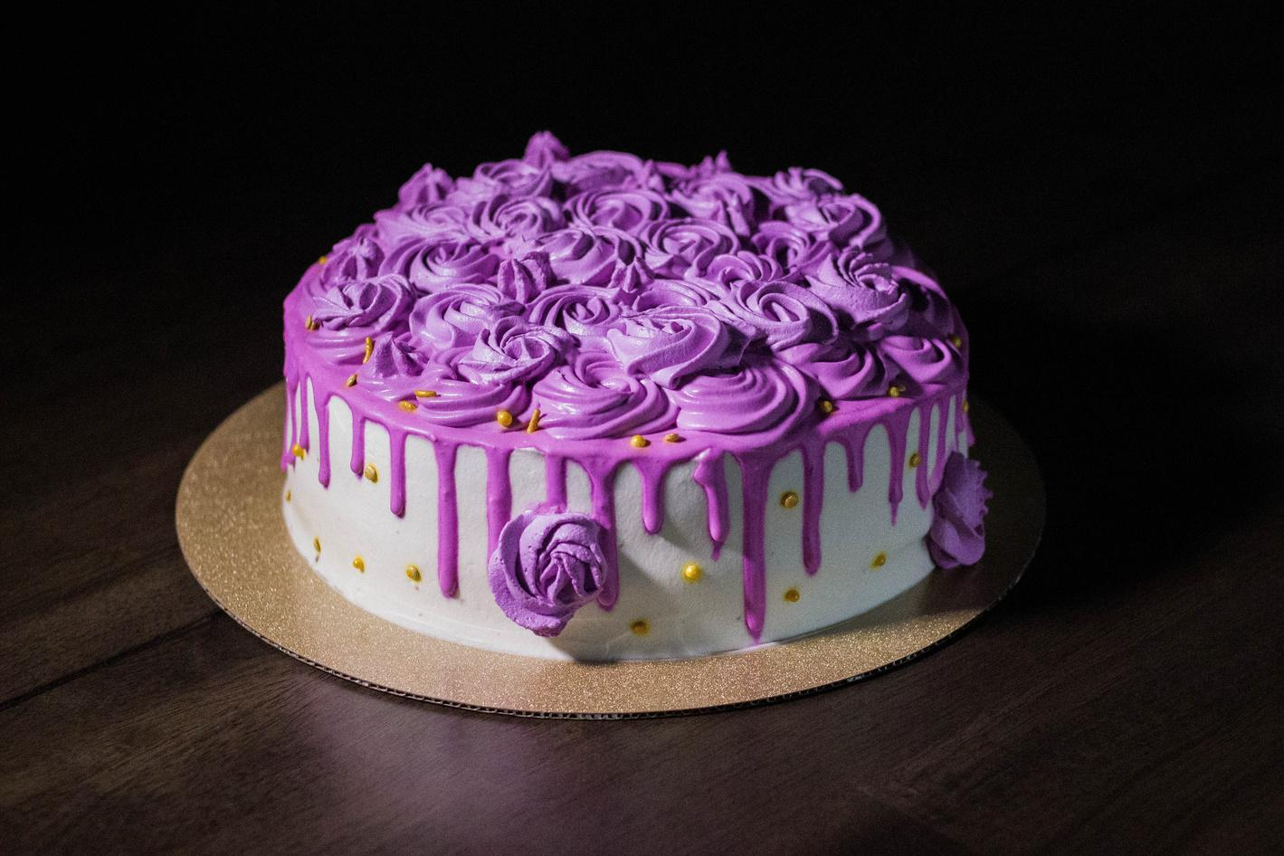
Use Cases
Professional Bakers
at Bakeries or any sort of restaurant who need structured instructions and quickly access recipes to save time
Beginner Bakers
at home beginner bakers that can easily find recipes without having to search multiple websites. The program provides instr. that make baking easier and less stressful.
Anyone
Anyone craving cake and wanting to bake but don’t know where to start. They can choose the random option to discover a new cake recipe instantly.

Slide 5
Technology
New Technology being used APIs
- The Birthday Cake DB API
Python Modules Used:
Random- to get the computer to select a random cake if prompted
Webbrowser- used to pull up an image of the selected cake
Json- to read and convert the API data into Python and lists so that the recipe ingredients is simply accessible

Slide 6
When you run the program, a welcome message pops up along with a list of the 59 cakes available to view.
User is then asked to input the number associated with the cake they’d like to see, “random” to view a random cake or “q” to leave the program.
If the user chooses a specific cake or random, the cake information is displayed such as the name, difficulty, portion, time to make and its description. The ingredients are then listed and the step by step numbered instructions after.
The user then has the option to view a picture of the cake.
Finally, the user has the option to view another cake or leave the program.
Program
Flow

Slide 7
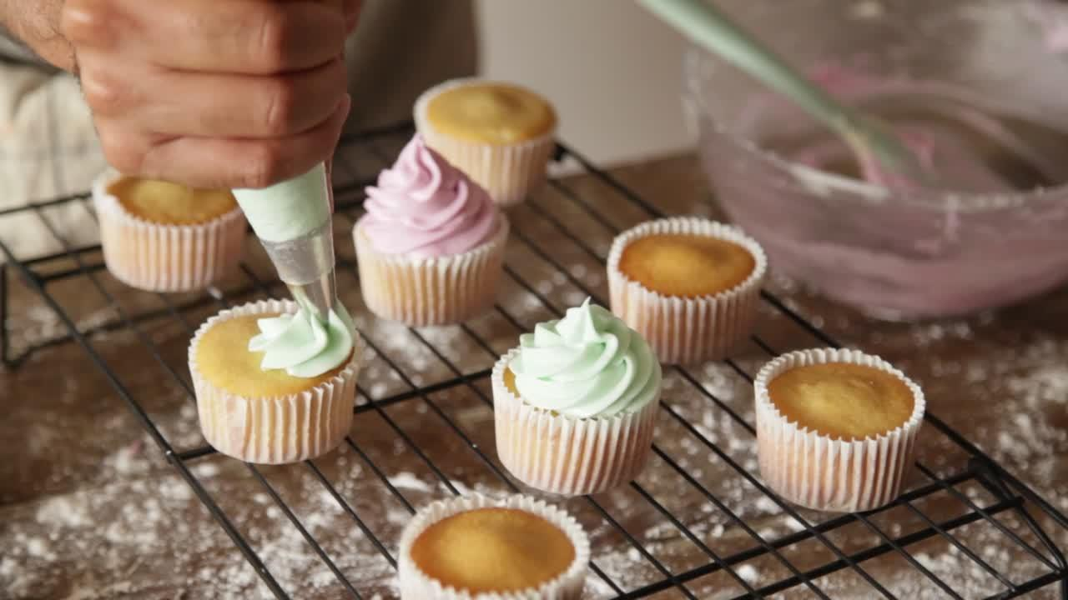
Errors we encountered
Errors: After asking if the user wanted to see a picture of their cake, they had to say yes or no. If they typed something else like “maybe”, the program would break without asking the user to enter “yes” or “no” again.
Solutions: Added a “break” under the new while loop where the user has the option to rerun the program. Without it, the program would keep looping itself even after saying “no” which is supposed to quit the program.

Slide 8
MEET THE TEAM
Diego
Will
Yaquelin
Perla
Melanie
Function Declaration
Exception handling
Communications-APIs
Research
User input, modules

Slide 9
Related Documents
https://youtu.be/NjHKITKVWZA?si=ltmWKduviZ4-4NrP (For webbrowser tutorial)
https://docs.python.org/3/library/webbrowser.html (For webbrowser module)
https://rapidapi.com/rapihub-rapihub-default/api/the-birthday-cake-db/playground/apiendpoint_b77303d6-4efc-4941-84de-87b0e7e7be75 (the api we used )

Slide 10
THANK YOU!
Do you have any questions?

